Slide 1
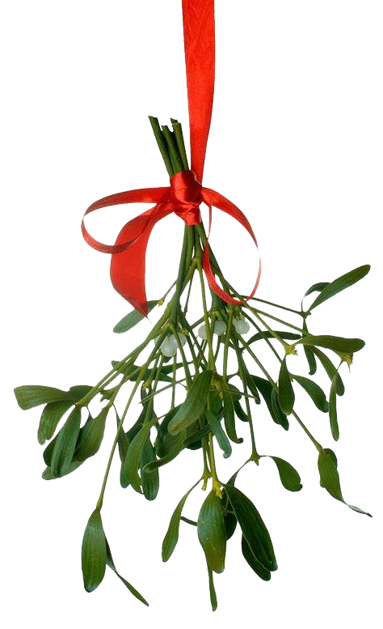
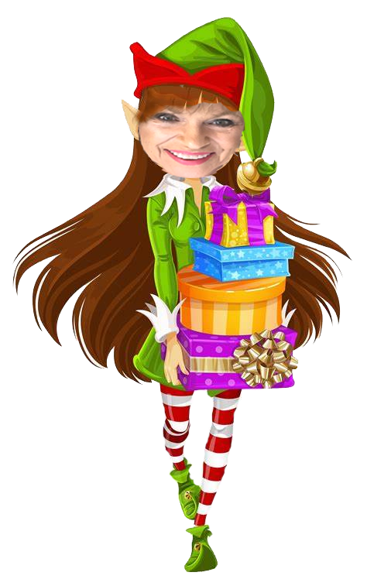
Welcome to our
Holiday
Wonderland

Slide 2
NAME: _________________
Cell Phone: _________________
Ticket Booth
A B C
Link to survey: https://forms.gle/i9aHytcnygRtwki7A

Slide 3
Holiday Wonderland
Stocking
Stuffers

Slide 4
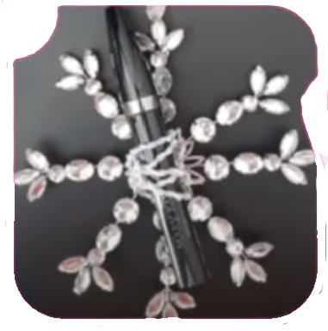
Snowflake Ornaments
$15
$17
Mascara
Mk Oil-Free Eye Makeup Remover

Slide 5
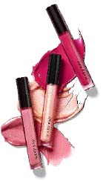
12 Lips of Christmas
$16
Unlimited Lip Gloss
12 Lip Special
$175

Slide 6
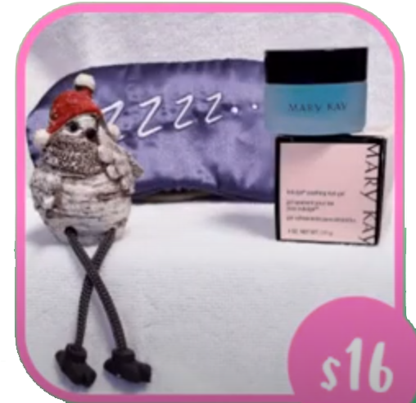
Sweet Dreams
$16
Indulge Soothing Eye Gel

Slide 7
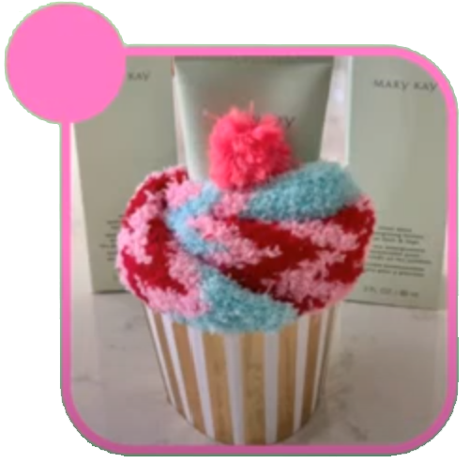
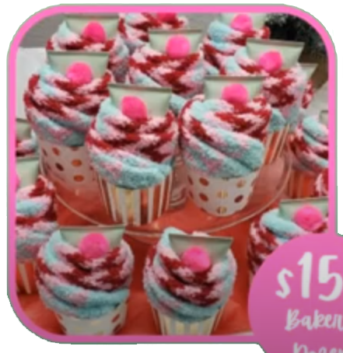
Mint Bliss Cupcakes
$15
$150
Bakers
Dozen
Mint Bliss Energizing Lotion

Slide 8
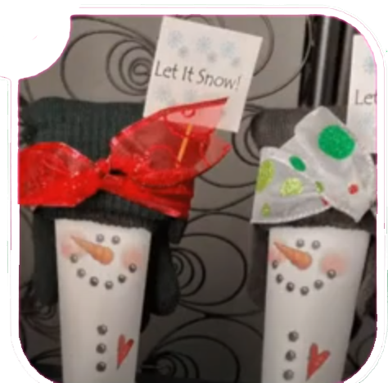
Snow Buddies
$15
Satin Hands Nourishing Shea Cream

Slide 9
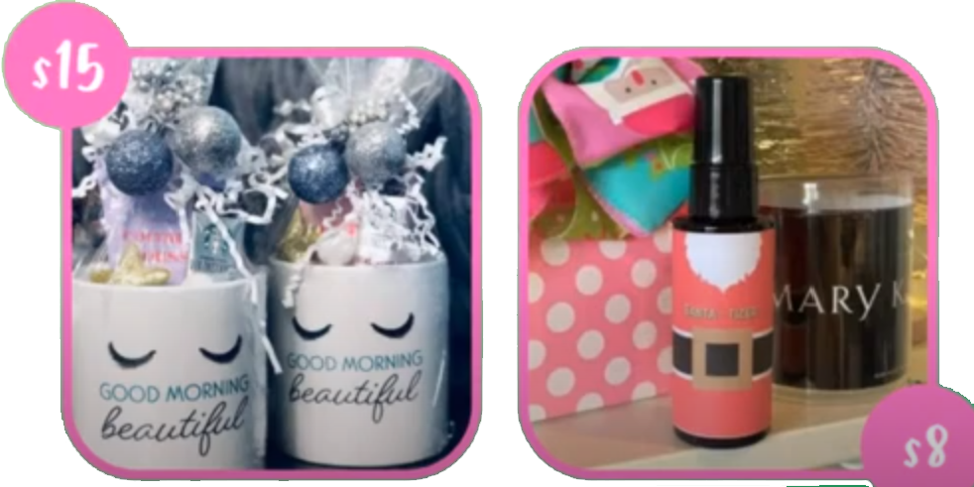
Coffee & Cream
$15
$8
Satin Hands Nourishing Shea Cream
Satin Hands Shea Hand Sanitizer

Slide 10
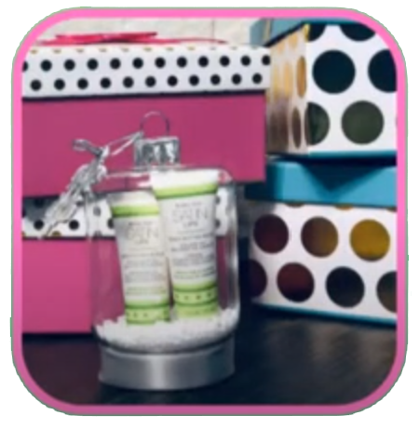
Mistletoe Prep Kit
$22
Satin Lips Set
(Shea Sugar Scrub & Shea Butter Balm

Slide 11
Holiday Wonderland
Gifts
For Her

Slide 12
Satin Hands Pampering Set
$36
Spa
in a
Jar
Satin Hands pampering Set

Slide 13
Soothing Satin Set
$58
Satin Hands Shea Hand Soap
Satins Hands Pampering Set
Satin Lips Shea Butter Balm

Slide 14
Skinvigorate Sonic System
$75
$100
Skinvigorate Sonic Skin Care System w/Cleansing Brush
Skinvigorate Sonic Skin Care System Massage Head

Slide 15
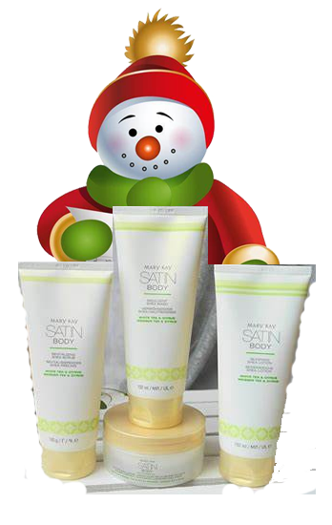
Satin Body Collection
$54
$18
ea
Satin Body Revitalizing Shea Scrub
Satin Body Indulgent Shea Wash
Satin Body Silkening Shea Lotion
Satin Body Whipped Shea Creme

Slide 16
Everyday Escape Bundle
$147
unrolled
Travel Roll-Up Bag
Satin Hands Revitalizing Shea Scrub
Satin Body Indulgent Shea Wash
Satin body Silkening Shea Lotion
Satin Lips SheaSugar Scrub
Satin Lips Shea Butter Balm
Satin ands Pampering Set

Slide 17
You Light the Way
$30
$70
Experience Illuminating Elegance with
Mary Kay’s newest
Illuminea Extrait de Parfum & Body Souffle

Slide 18
Perfectly Paired 1
Pair with
A Gift
Certificate
For any amount
$18
unfilled
Mary Kay Perfect Palette

Slide 19
Perfectly Paired II
$35
Pair with
A Gift
Certificate
For any amount
Mary Kay Travel Roll-Up Bag

Slide 20
Holiday Wonderland
Gifts
For Him

Slide 21
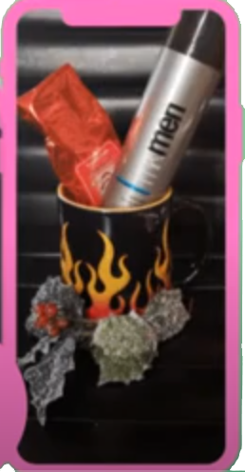
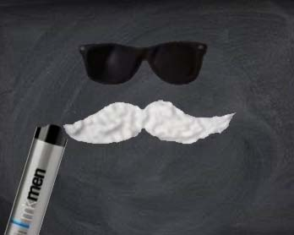
Man Mug
$18
MK Mens Shave Foam

Slide 22
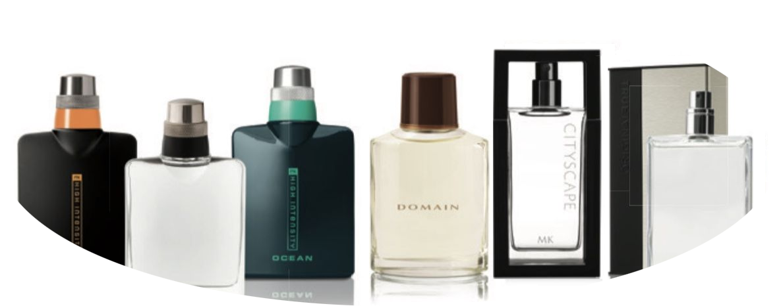
Fragrances for Him
MK High Intensity Sport, $40
MK High Intensity Spray, $40
MK High Intensity Ocean, $42
Domain Cologne Spray, $50
True Original Cologne Spray, $36

Slide 23
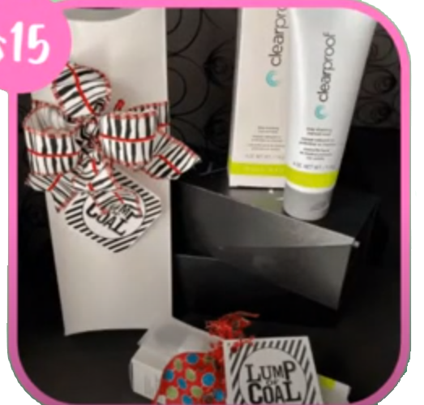
Lump of Coal
$24
Clear Proof Deep Cleansing Charcoal Mask

Slide 24
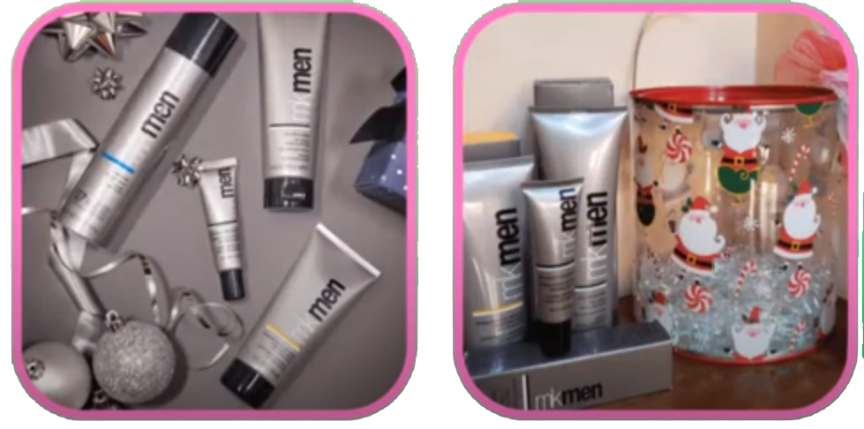
Man Can
MK Men Daily Facial Wash
Mk Men Shave Foam
Mk Men Facial Hydrator Sunscreen SPF 30
Advanced Eye Cream

Slide 25
Holiday Wonderland
Limited
Edition

Slide 26
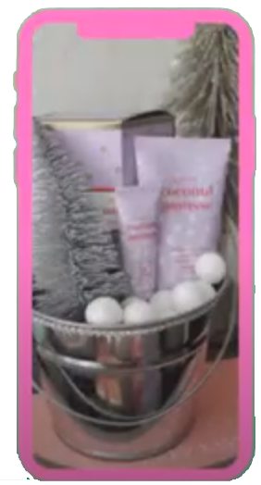
Darling Delights
$18
So
cute
Darling Delight Hand Cream
Darling Delight Lip Balm
Available in Tropical Coconut Mousse,
Sweet Berry Parfait and Luscious Citrus Sorbet

Slide 27
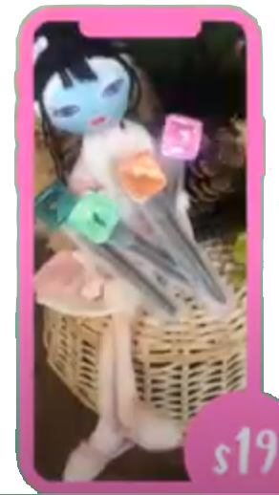
Mad About Masking
Pop
of
your
choice
$25
$19
Mad about Masking Pods Set
Masking Pods on Mask Applicator to make Pop of your choice

Slide 28
Beauty on the go
$12
$15
$12
$39
Mini Essential Brush Set
MK Eye Lash Curler
Mini Blending Sponge Set

Slide 29
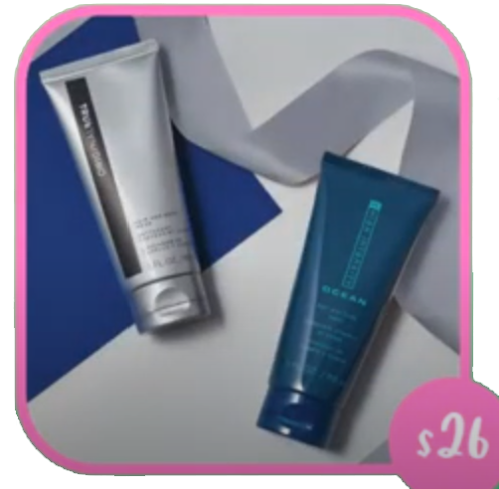
Men’s Power Pack
$26
MK Mens Hair and Body Wash Gift Set

Slide 30
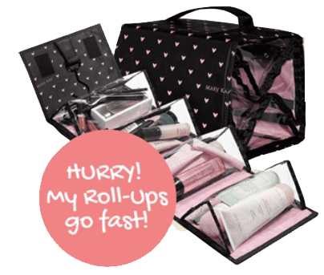
NATIONAL STUFFING DAY
Party with me & Stuff a Roll UP
It’s National Stuffing Day...and MK Consultants are celebrating .. All Hostesses that hold a party w/4+ guests & $200+ sales & get FREE Roll Up bag, and can stuff it for 40% off!!!
STUFF YOUR
ROLL-UP BAG
WITH PRODUCTS.
ASK ME HOW YOU
CAN GET YOUR
ROLL-UP TODAY!

