Slide 1
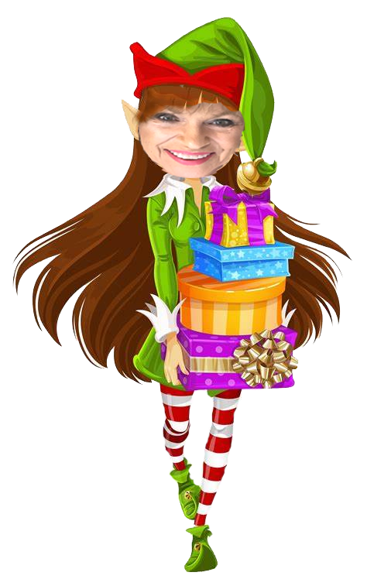
Holiday Wonderland
Limited
Edition

Slide 2
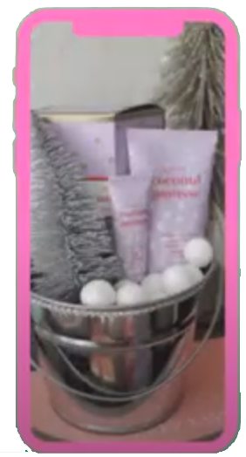
Darling Delights
$18
So
cute
Darling Delight Hand Cream
Darling Delight Lip Balm
Available in Tropical Coconut Mousse,
Sweet Berry Parfait and Luscious Citrus Sorbet

Slide 3
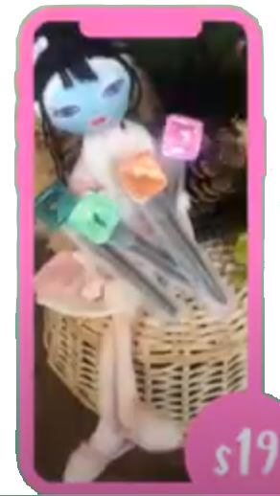
Mad About Masking
Pop
of
your
choice
$25
$19
Mad about Masking Pods Set
Masking Pods on Mask Applicator to make Pop of your choice

Slide 4
Beauty on the go
$12
$15
$12
$39
Mini Essential Brush Set
MK Eye Lash Curler
Mini Blending Sponge Set

Slide 5
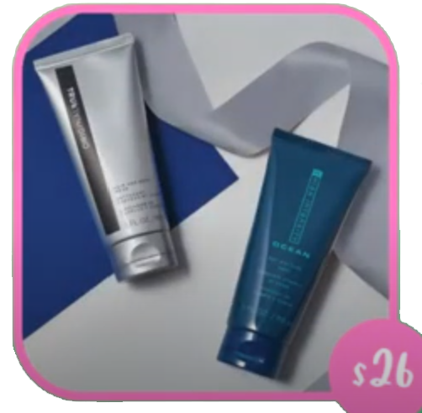
Men’s Power Pack
$26
MK Mens Hair and Body Wash Gift Set

