Slide 1
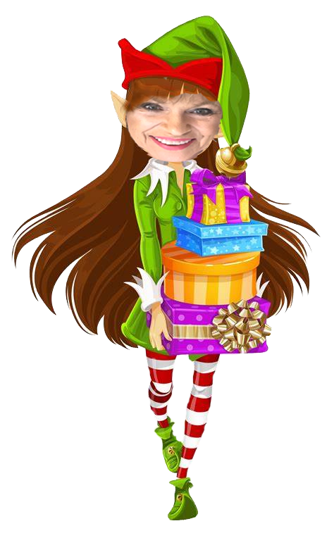
Holiday Wonderland
Stocking
Stuffers

Slide 2
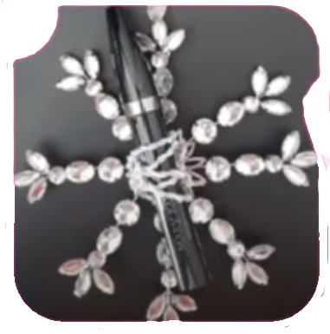
Snowflake Ornaments
$15
$17
Mascara
Mk Oil-Free Eye Makeup Remover

Slide 3
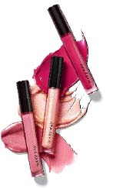
12 Lips of Christmas
$16
Unlimited Lip Gloss
12 Lip Special
$175

Slide 4
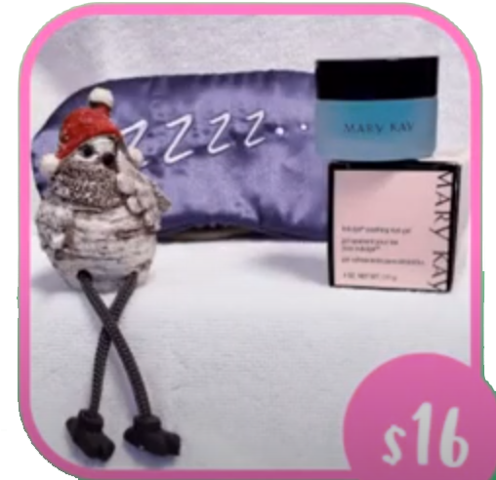
Sweet Dreams
$16
Indulge Soothing Eye Gel

Slide 5
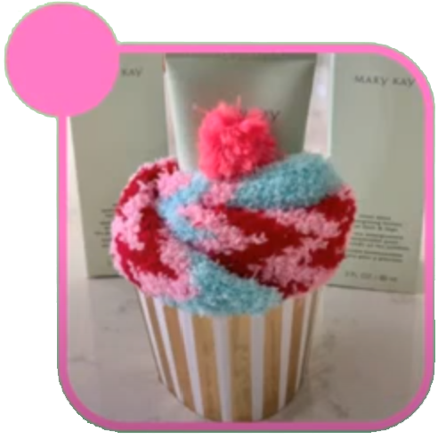
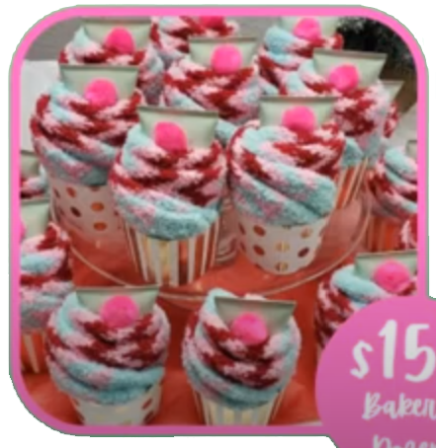
Mint Bliss Cupcakes
$15
$150
Bakers
Dozen
Mint Bliss Energizing Lotion

Slide 6
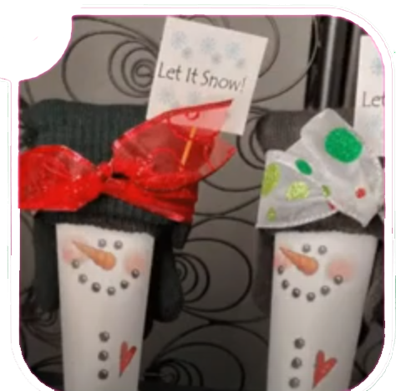
Snow Buddies
$15
Satin Hands Nourishing Shea Cream

Slide 7
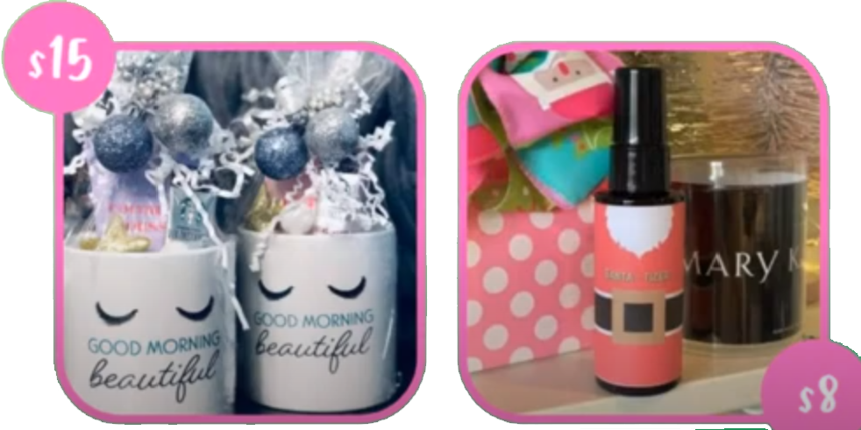
Coffee & Cream
$15
$8
Satin Hands Nourishing Shea Cream
Satin Hands Shea Hand Sanitizer

Slide 8
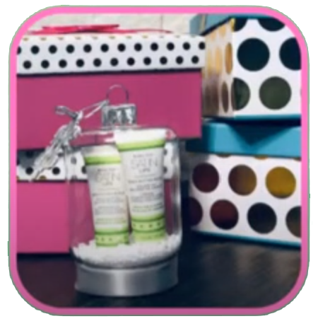
Mistletoe Prep Kit
$22
Satin Lips Set
(Shea Sugar Scrub & Shea Butter Balm

