Slide 1
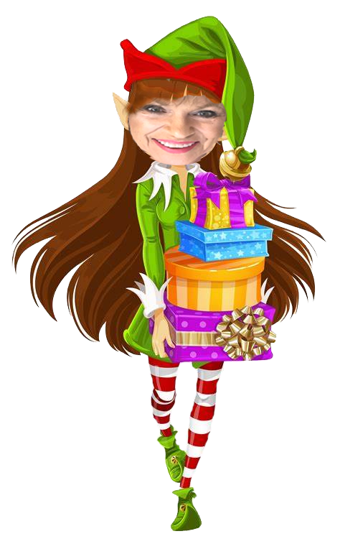
Holiday Wonderland
Gifts
For Him

Slide 2
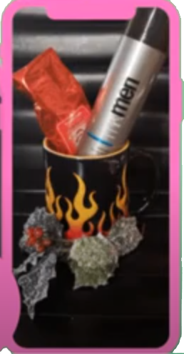
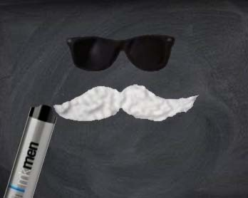
Man Mug
$18
MK Mens Shave Foam

Slide 3
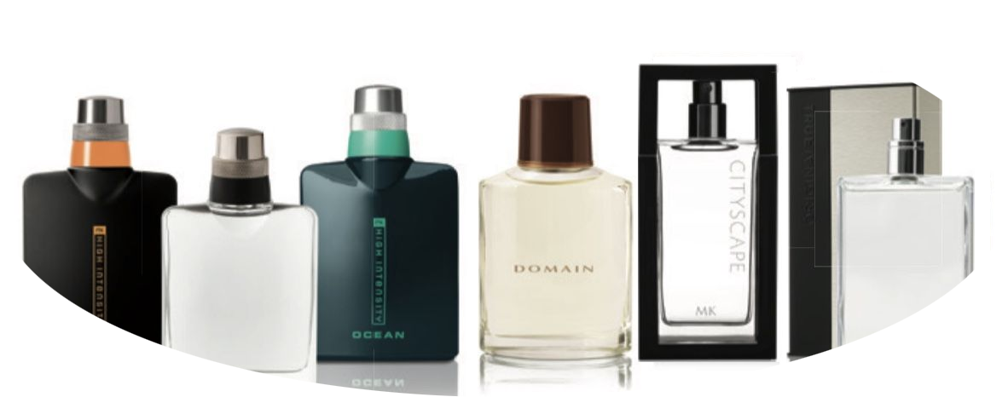
Fragrances for Him
MK High Intensity Sport, $40
MK High Intensity Spray, $40
MK High Intensity Ocean, $42
Domain Cologne Spray, $50
True Original Cologne Spray, $36

Slide 4
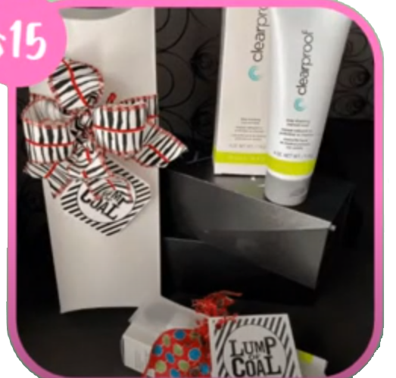
Lump of Coal
$24
Clear Proof Deep Cleansing Charcoal Mask

Slide 5
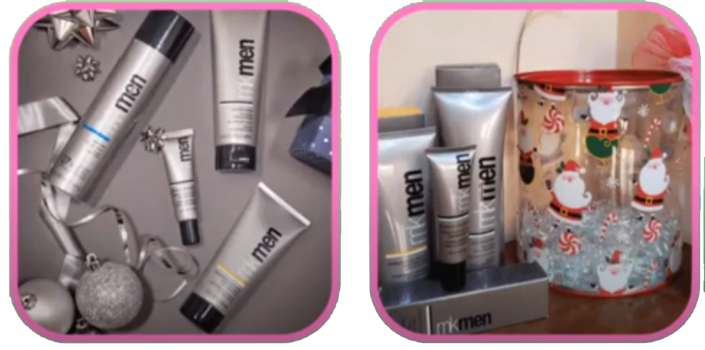
Man Can
MK Men Daily Facial Wash
Mk Men Shave Foam
Mk Men Facial Hydrator Sunscreen SPF 30
Advanced Eye Cream

