Slide 1
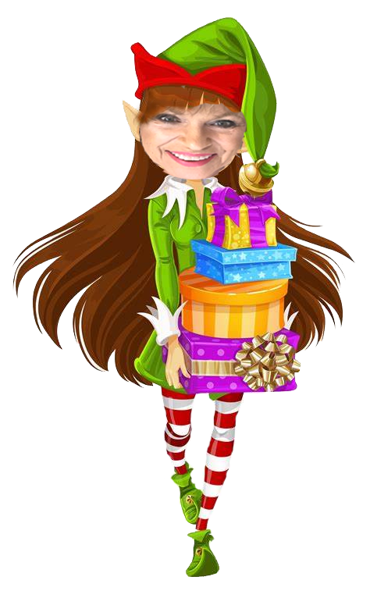
Holiday Wonderland
Gifts
For Her

Slide 2
Satin Hands Pampering Set
$36
Spa
in a
Jar
Satin Hands pampering Set

Slide 3
Soothing Satin Set
$58
Satin Hands Shea Hand Soap
Satins Hands Pampering Set
Satin Lips Shea Butter Balm

Slide 4
Skinvigorate Sonic System
$75
$100
Skinvigorate Sonic Skin Care System w/Cleansing Brush
Skinvigorate Sonic Skin Care System Massage Head

Slide 5
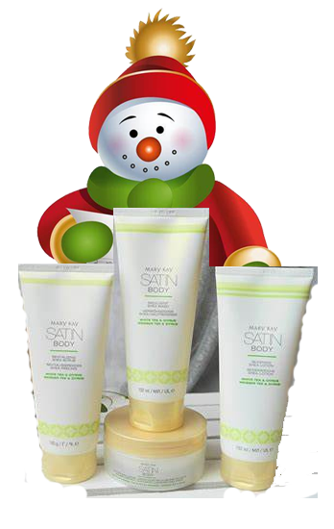
Satin Body Collection
$54
$18
ea
Satin Body Revitalizing Shea Scrub
Satin Body Indulgent Shea Wash
Satin Body Silkening Shea Lotion
Satin Body Whipped Shea Creme

Slide 6
Everyday Escape Bundle
$147
unrolled
Travel Roll-Up Bag
Satin Hands Revitalizing Shea Scrub
Satin Body Indulgent Shea Wash
Satin body Silkening Shea Lotion
Satin Lips SheaSugar Scrub
Satin Lips Shea Butter Balm
Satin ands Pampering Set

Slide 7
You Light the Way
$30
$70
Experience Illuminating Elegance with
Mary Kay’s newest
Illuminea Extrait de Parfum & Body Souffle

Slide 8
Perfectly Paired 1
Pair with
A Gift
Certificate
For any amount
$18
unfilled
Mary Kay Perfect Palette

Slide 9
Perfectly Paired II
$35
Pair with
A Gift
Certificate
For any amount
Mary Kay Travel Roll-Up Bag

