Slide 3
$16

Slide 4
$25

Slide 5
$26

Slide 6
$15
$12

Slide 7
$18

Slide 8
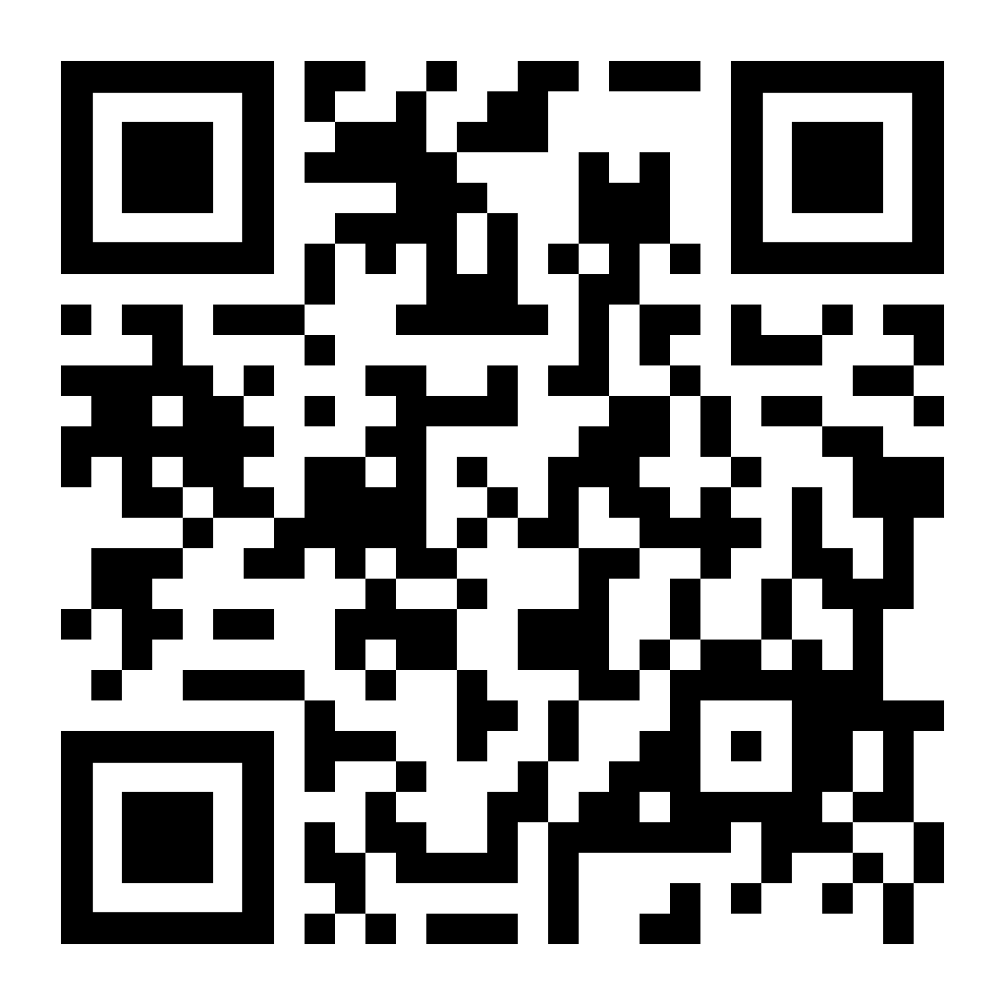
5in5 Survey

